Slide 1
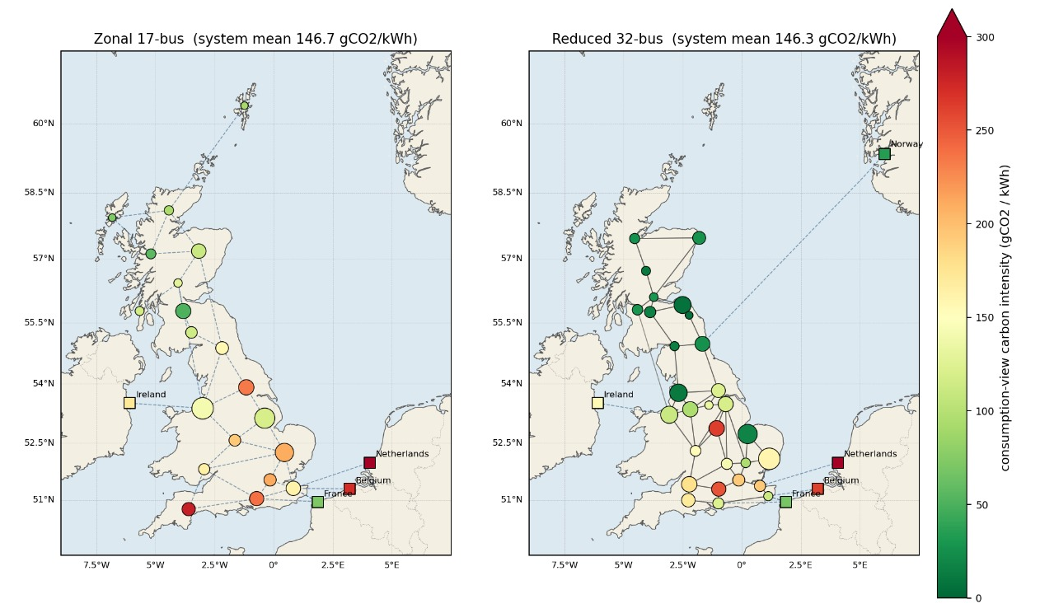
NESO CARBON INTENSITY PROJECT
THE PIPELINE
CARBON INTENSITY RESEARCH · 2026
Imperial College London · ELEC60014
Group project in collaboration with NESO
Mapping the Carbon Cost of Every Electron
on Britain's Grid
01
WHY THIS MATTERS
Dispatch Simulation
National carbon intensity figures mask a 900+ gCO₂/kWh spread between the cleanest and dirtiest nodes on the GB grid.
Without nodal resolution, grid investment decisions, carbon contracts, and demand-response strategies are flying blind.
This model provides the spatial granularity needed to make those decisions intelligently.
PyPSA-GB optimises generation dispatch across the full GB network using 2023 historical data. Transmission losses (8%) and NESO's biomass factor (120 gCO₂/kWh) are explicitly modelled.
02
A nodal power flow model computing carbon intensity at every bus of the GB electricity network — hour by hour across 2023.
Tracing by Bialek method
Target clean investment where it reduces emissions most
Average proportional sharing attributes carbon from each generator to every bus — assigning a precise carbon intensity at each node at every timestep, not just a system average.
Enable location-aware carbon contracts and pricing
Support NESO's regional reporting with validated nodal data
Open-source and reproducible — built on PyPSA-GB
2,130
Network buses modelled
Geographic carbon intensity map — GB transmission network · Mean nodal CI across 2,130 buses · Full year 2023
8,760
Hourly snapshots (2023)
03
Validation
28.3
Best model RMSE gCO₂/kWh
Nodal results are aggregated to NESO's 17 regional zones and benchmarked against the official Carbon Intensity API. Annual output of 272–273 TWh sits within 1% of GB's 2023 actual.
0.936
Pearson r (32-bus vs NESO)
github.com/avagm/neso-carbon-intensity
Mert · Annie · Ava · Matthew · Momo · Adnan
Imperial College London · May 2026
In collaboration with National Energy System Operator
NESO Carbon Intensity Project · Imperial College London · 2026

Slide 2
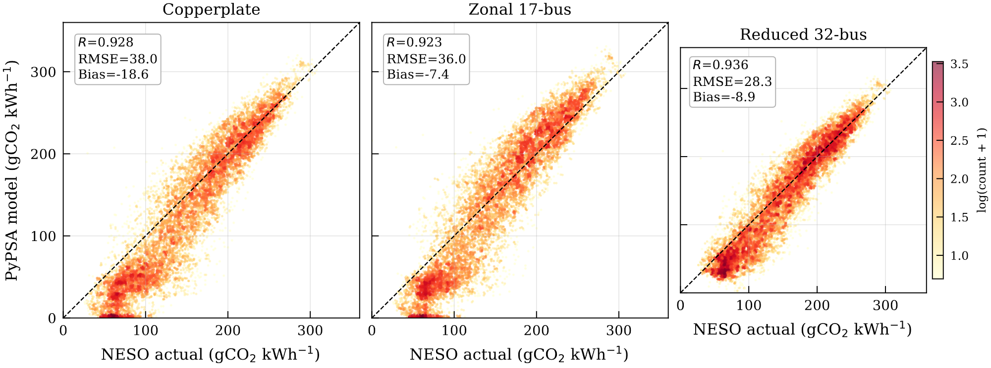
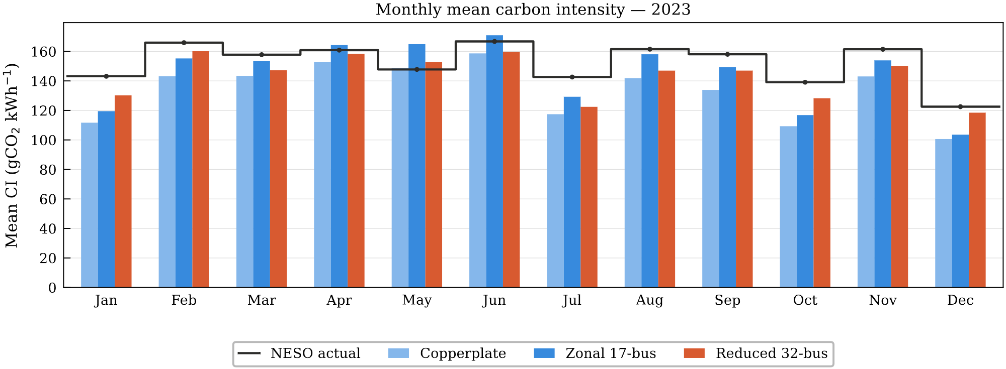
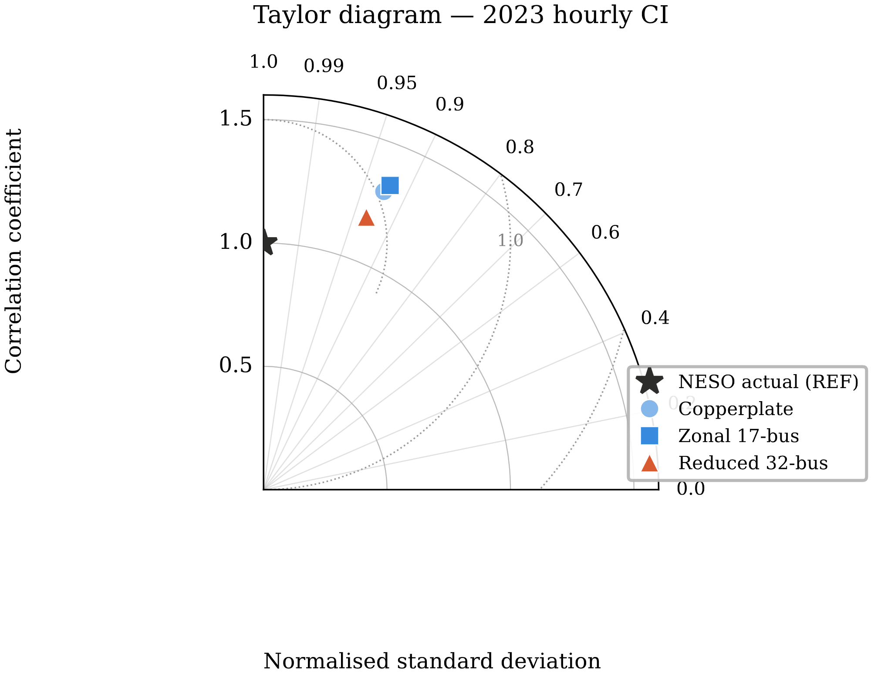
KEY RESULTS
VALIDATION METRICS
THE PROBLEM
−25%
32-bus model vs NESO Carbon Intensity API · Full year 2023 · NESO actual mean: 152.1 gCO₂/kWh
The UK electricity grid must decarbonise fast. But national average carbon intensity figures hide a critical truth: not all electrons are equal.
Knowing the system average tells you little about where investment in clean generation or grid infrastructure will have the greatest impact.
Emissions are unevenly distributed — from 0 gCO₂/kWh at nuclear and wind buses to over 900 gCO₂/kWh at thermal hotspots. Without nodal visibility, investment decisions are made blind.
RMSE reduction with network topology
Metric | Copperplate | 17-zone | 32-bus
RMSE (gCO₂/kWh) | 38.0 | 36.0 | 28.3
Pearson r | 0.928 | 0.923 | 0.936
Bias (gCO₂/kWh) | −18.6 | −7.4 | −8.9
Annual CO₂ (Mt) | 37.3 | 40.2 | 40.2
Adding network constraints reduces RMSE from 38.0 (copperplate) to 28.3 gCO₂/kWh (32-bus) — a 25% improvement over the simplest model.
0.936
Key finding: Adding network topology reduces RMSE by 25% and nearly halves the bias. Both network models produce the physically correct 40.2 Mt total emissions vs copperplate's 37.3 Mt — confirming grid constraints matter.
Pearson r — 32-bus vs NESO actuals
The 32-bus model achieves the highest correlation with NESO's published Carbon Intensity API across all 8,760 hourly snapshots in 2023.
PyPSA model vs NESO actual carbon intensity · All three model configurations · 8,760 hourly snapshots · 2023
OUR SOLUTION
We built a full-year, nodal-resolution carbon intensity model using PyPSA-GB as the dispatch engine and Bialek average proportional sharing to attribute carbon to every node in the network.
The result is a validated, open-source tool that maps emissions spatially across the GB network at unprecedented granularity — benchmarked against NESO's Carbon Intensity API.
40.2
Annual CO₂ emissions (Mt) — network models
Both 17-zone and 32-bus models produce 40.2 Mt — physically correct. Copperplate underestimates at 37.3 Mt, confirming grid constraints matter.
Monthly mean carbon intensity 2023 — 32-bus model tracks NESO actuals most closely year-round
Taylor diagram showing 32-bus model closest to NESO reference across correlation and standard deviation
−8.9
Mean bias gCO₂/kWh (32-bus model)
Bias reduced from −18.6 (copperplate) to −8.9 gCO₂/kWh with network topology — nearly halved, and consistent across the year.
Imperial College London · ELEC60014 · May 2026

